Slide 1
Annexure -B
e- Process audit software updation (Additional Requirements)

Slide 2
FLOW FOR CONDUCTING PROCESS AUDIT
Annexure -B
Preparation of manufacturing process audit annual plan, review & approval from HOD
Preparation of audit schedule & assigning auditors in the e- process audit system
Circulation of audit schedules to Auditor’s/HOD’s/Auditee’s through mail
Conducting manufacturing process audit & discuss with auditee’s/HOD and sign-off NC memo with Auditee for nonconformances
Assigning Follow up Auditor
Implementation of corrective and preventive actions with in EDC & Request for Follow Up audit through e- process audit portal.
Entering of corrective & preventive actions & submission of EDC for NCR’s/ suggestions in e- process audit portal
Entering of NCR’s/suggestions and Audit closing in e-process audit portal & Preparation and submitting of Audit report
EDC crossed
Request for EDC Extension & get approval from Process HOD in e-process audit portal
Verification of Corrective and preventive actions & entering of follow audit observations/closing of audit
Closing of NCR

Slide 3
FLOW FOR CONDUCTING PROCESS AUDIT
Annexure -B
Preparation of Mfg. Process Audit Schedule and assign Auditors in e-process audit system (as per annual Plan).
If any discrepancy/ deviation is observed during the process audit, Identify and record the observations and evidence in (Audit observation sheet, like suggestions & Major/Minor non-conformance(s) observed during an audit as per the criteria defined as below.
After audit completion, Auditor must be discussed along with Auditee’s & HOD’s and respective Process Engg. on Positive/Negative observations and scope for improvement points (Suggestions).
Update NCR’s Memo with a clear statement of non-conformity & objective evidence, and it must be sign-off with the concerned Auditee’s.
Decide NCR’s as Major/Minor and suggestions to be entered and “Close audit” must be done within 3-working days from completion of the audit in the e-Process Audit system. After the closing of the audit, the auditor cannot raise any NCR or suggestion in e- process audit system.
Concern Auditee must enter the Details of Nonconformance identified lot disposal & proposed corrective actions indicated with time frame “Expected Date of Completion” (EDC) for the completion of NCRs and suggestions will be entered in the e-process audit system. Auditee shall submit the EDC within 7 working days from raising the NCR in the e-process audit system.
Once NCR is raised, it remains open within the EDC & action progress till it gets closed satisfactorily. No, further NCR(s) will be made on open NCRs of previous audit(s).
The HOD of the audited area will initiate corrective actions as agreed in NCR and implement them within the defined EDC.
After completing the implementation of corrective action (s), Auditee will make the request for a follow-up audit in the e-process audit system. The concern process engineer will assign a follow-up auditor for the follow-up audit.
During the follow-up audit, the Effectiveness of implemented proposed corrective/preventive actions must be audited before NCR closing. The assigned auditor will enter follow-up audit observations in the e-process audit portal and the follow-up audit will be closed.
Process HOD will close the NCR -if the results of the follow-up audit are satisfactory. If, corrective actions are not satisfactory -Process HOD may reject the closer of NCR and corrective action need to be Re-entered again by the auditee and a follow-up audit to be done again to close the NCR.
In case, auditee is not able to close the NCR as per the agreed EDC, an EDC extension with a revised EDC has to be obtained in consultation with Process HOD in the e-process audit portal by entering proper reasons and the revised EDC has to be approved by Process HOD.

Slide 4
e-PROCESS AUDIT SOFTWARE UPDATION
Annexure -B
Existing
Proposed
S. NO | Department | Auditee | No. of NCR's Raised
1 | ABD3-Assembly | Karthik L | 1
S. NO | Auditee | NCR Observation | NCR Explanation | Major/ Minor | Repeated NCR
1 | ABCD | Poka-Yoke verification was not effective. | Poka-yoke verification was done with a layer audit checklist. A poka-yoke interlink logic is provided: "If the mold temperature goes below or above trim die will stop. But, there is no clear plan on how to verify poka-yoke in the shop floor. | Major | Y
2 | ABCD | Work instruction is not inline to the Control plan in grid casting for bend test | The control plan says, Stop M/C and give the touch-up / scrape the mold and restart the M/C Ref: ABD1-WIN-04/06 & 07. | Minor | N
With in One Week, Provide EDC for NCRs; Link
With in 7-Days, Provide EDC for NCRs in e-Process Audit Portal: Link

Slide 5
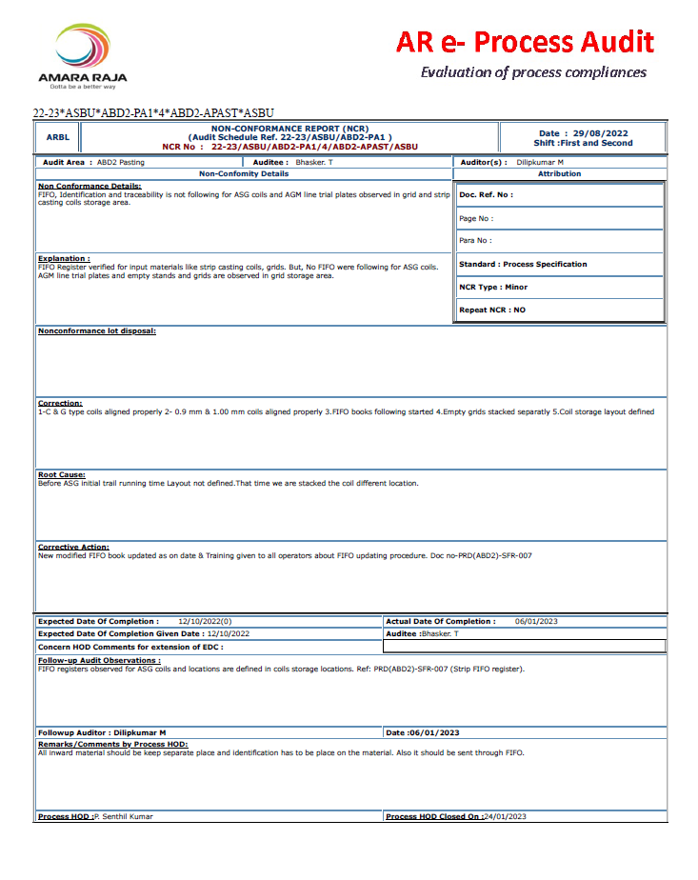
e-PROCESS AUDIT SOFTWARE UPDATION
Annexure -B
Existing
Proposed
Statement of
non-conformity
Objective evidence
“Justification for Classifications” need to include
Format No.: PCE-SFS-03 Need to be add in format.
At present manually writing the format due to unavailability of format number.
If format number available we shall file the format generated in e-process audit portal
Format No.: PCE-SFS-03

Slide 6
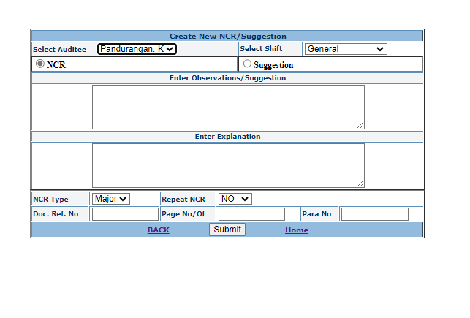
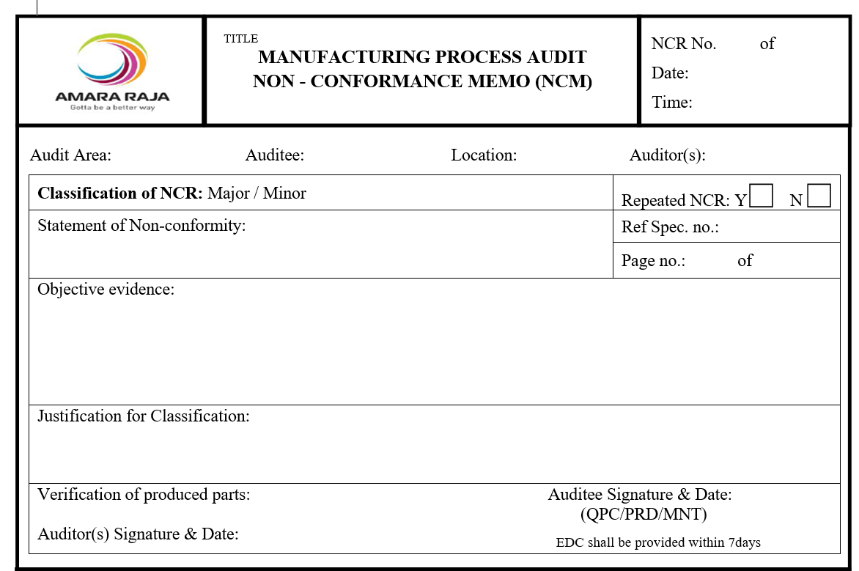
e-PROCESS AUDIT SOFTWARE UPDATION
Annexure -B
Existing
Proposed
Statement of
non-conformity
Objective evidence
“Justification for Classifications” need to include

Slide 7
e-PROCESS AUDIT SOFTWARE UPDATION
Annexure -B
Existing – Detailed report
S.No | NCR No | Status | NCR Created Date | Audit Reference | Department | Auditee | Auditor | Shift | Standard | Major/Minor | Non-Conformance Details | Explanation | Corrective Action | EDC Given Date | EDC | ADC | Follow-up Audit Observations | Followup Auditor | Followup Audit Date | Followup Audit Req. Date | Rev. EDC. | EDC extension reasons | Process HOD | Process HOD Remarks | Process HOD Closed Date
1 | 22-23/ASBU/TBD-PA1/1/TBD-AOP/ASBU | Closed | 9/1/2022 | 22-23/ASBU/TBD-PA1 | TBD Oxide Plant | Murari R | Radhaiah. C | G | Process Specification | Minor | No evidence for melt pot dross addition. | As per specification, add approximately 2 kg of melt pot dross to the reactor pot every 2 hrs. But, there is no evidence for adding in this manner. | Dross addition in reactor pot is being monitored and noted in separate log book | 10/12/2022 | 11/8/2022 | 11/22/2022 | Presently, Lead melt pot dross adding into the respective reactor pot at the ratio of 2kg per 2 hours once manually, also evidence of dross addition is maintained by the production team. | Vaseem Akram D | 10/29/2022 | 11/22/2022 | 11/8/2022 | Presently Dross addition is being followed and registered in the separate logbook | 1000465 | Ensure the quantity of dross addition into the reactor pot. | 11/22/2022
Proposed – Detailed report
S.No | NCR No | Status | NCR Created Date | Audit Area | Auditee | Auditor | Shift | Standard | Statement of Non conformity | Objective evidence | Major/ Minor | Repeated NCR | Correction | Root cause | Corrective Action | EDC Given Date | EDC | ADC | Rev. EDC. | EDC extension reasons | Followup Audit Req. Date | Followup Auditor | Followup Audit Date | Follow-up Audit Observations | Process HOD | Process HOD Remarks | Process HOD Closed Date
1 | 22-23/ASBU/TBD-PA1/1/TBD-AOP/ASBU | Closed | 9/1/2022 | TBD Oxide Plant | Murari R | Radhaiah. C | G |  | No evidence for melt pot dross addition. | As per specification, add approximately 2 kg of melt pot dross to the reactor pot every 2 hrs. But, there is no evidence for adding in this manner. | Minor | No | Dross addition in reactor pot is noted in separate log book | Earlier dross addition was not monitored. | Dross addition in reactor pot is being monitored and noted in separate log book | 10/12/2022 | 11/8/2022 | 11/22/2022 | 11/8/2022 | Presently Dross addition is being followed and registered in the separate logbook | 11/22/2022 | ` | 10/29/2022 | Presently, Lead melt pot dross adding into the respective reactor pot at the ratio of 2kg per 2 hours once manually, also evidence of dross addition is maintained by the production team. | 1000465 | Ensure the quantity of dross addition into the reactor pot. | 11/22/2022
Inference:
Audit reference point removed
Department Heading were changed as Audit area
Repeated NCR, Root cause & Corrections were added to the master list
Sequence of table were interchanged.

Slide 8
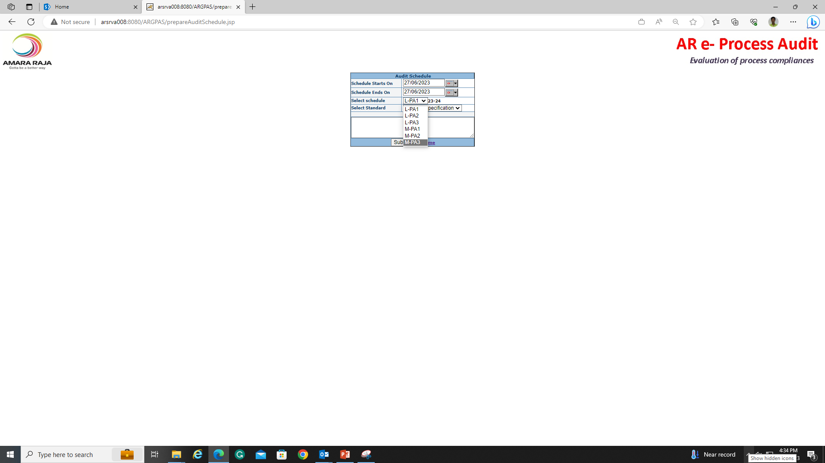
e-PROCESS AUDIT SOFTWARE UPDATION
Annexure -B
S. NO | Requirements | Before Updation | After Updation
1 | Pop-up mail for EDC submission, Extension & Follow-up audit assigned | There is No controls with Pop-up mail alert to the Auditees for EDC submission and extension | Alert for EDC submission: Auto Pop-up mail need to be send to Auditee did not give the EDC within 7Days from the date of close audit. Alert for EDC crossing: Auto Pop-up mail need to send to auditee along with respective HOD’s if it EDC was at ending stage (Before 2Days). Mail communication for follow-up audit assigned to concern auditor.
2 | Audit must be scheduled based on Annual plan and customer complaints, process changes, internal/external nonconformities | only schedule planning as per annual plan | Audit schedule screen shall be modified Audit must be planned based on customer complaints, process changes, internal/external nonconformities
3 | Auto Pop-up mail for entries | Auto mail entry control available with the IT team | Auto pop-up mail entries controls required at Process HOD ID for easy modification during top management changes
4 | Auto lock provision required for Audit closing | -- | Close audit should be locked after 5 days completion w.r.to the schedule end date
5 | Inclusion of dash board concept in portal | -- | Auto Dash board should be circulated to top management team through e-process audit portal.
6 | Required controls on Submission option after all fields filled. | -- | Submission option should be in Disable upto the all fields are filled
7 | Filter option required for fields | -- | To show the only applicable data to the external auditors/ customers
8 | Provision required to modify the correction, Root cause & Corrective action statements given by auditees | -- | Correction, Root cause & Corrective action statements are uploading in Auditees ID. But, options required to modify those statements in Process HOD ID.

